Slide 1


Project 1
The Cutlery Group

Slide 2


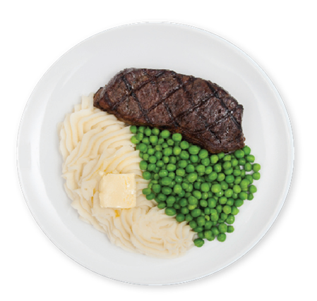
Agenda
Introduction of Data
Does Pricing influence Rating and Number of Reviews
Does Population Size influence Rating
Does Population affect the Number of Reviews
Sample Biases
How can We Improve Our Analysis

Slide 3




Introduction
The Cutlery Group conducted analysis to determine whether ratings supported food quality . Also does the price point matter in determining what’s considered a great experience? Are there cities that review more than others? This analysis will be conducted utilizing Google API for restaurant data and the Census API to determine the cities for comparison.

Slide 4


Data Cleaning

Slide 5
Data Cleaning
Pulled city populations from World Population Review (worldpopulationreview.com)
Pulled restaurant information from Google API
Filtered cities by population (>1,000,000) and randomly pulled 10 cities
Filtered restaurants by Rating (>4.0) and Number of Reviews (>250)
Notes:
World population gave population size with latitudes and longitudes which allowed a merge into the Google API
Google API was used since it contained the rating and review information desired for analysis
The reason for 10 cities is to show proof of concept before expanding
-Quantify if correlation truly exists, costs deemed starting with 10 then expanding nation wide
Filtered restaurants to focus on a rating above 4.0 to differentiate between a good review and great review
>250 reviews give restaurants with a well established review base and reputation

Slide 6
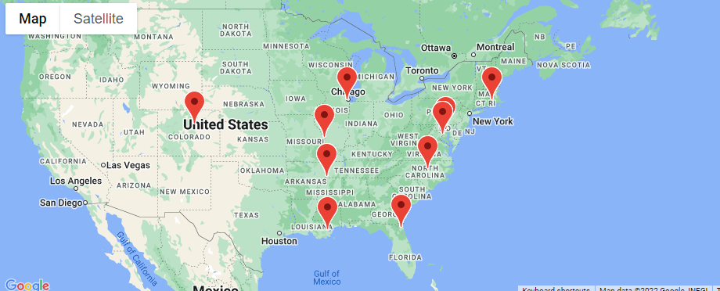
Location of Cities

Slide 7
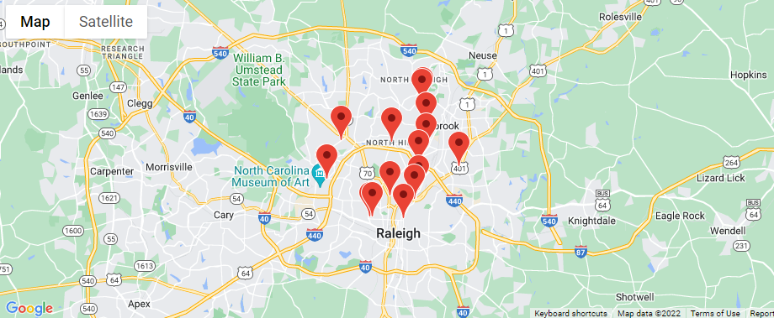
Restaurants in Cities

Slide 8
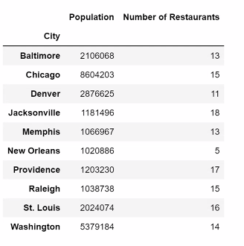
Number of Restaurants for Each City

Slide 9
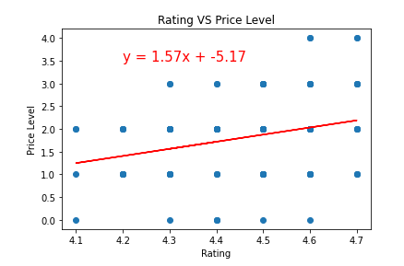
Does Pricing influence rating
R-Square Value is: 0.28
Notes:
Based on the data, there is a weak positive correlation based on a r squared value of 0.3

Slide 10
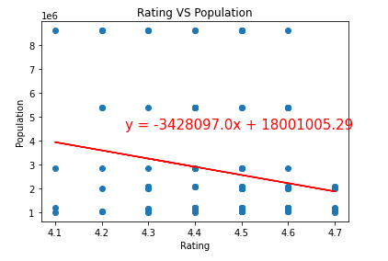
Does pricing influence the number of ratings
R-Square Value is: -0.21
Notes:
Based of the data, there is no correlation .
More people tend to got to a mid price restaurant than a high or low price restaurant. 2.0 has the most reviews

Slide 11
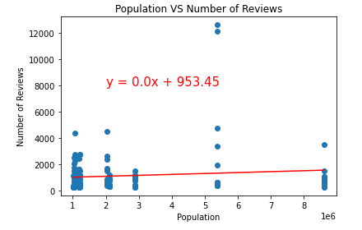
Does Population affect the number of reviews?
R-Square Value is: 0.11
Notes:
Try to x axis rotate 45°
Not culture based

Slide 12
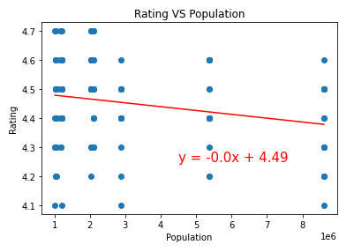
Does Population affect the rating?
R-Square Value is: -0.21
Notes:
Very weak correlation, larger populations tend to give lower ratings

Slide 13
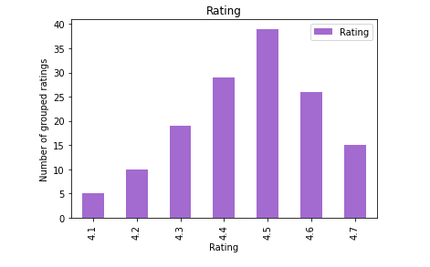
Does Population affect the number of reviews?
Notes:
Most given review was 4.5, data was truly random and well distibuted

Slide 14
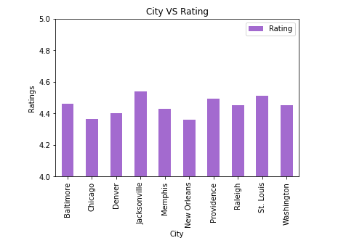
Does Population affect the rating?

Slide 15
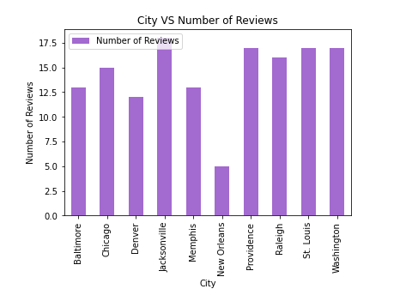
Conclusion
Brief summary

Slide 16

Summary
From the data we collected, there are some weak correlations between XXX and YYY. Further analysis is still required on a national scale to see if the correlation is stronger.

Slide 17


Thank You

